Slide 1
Visual Question Answer Sprint 3
A2_group 16
Yi Yang, Qilong Wang

Slide 2
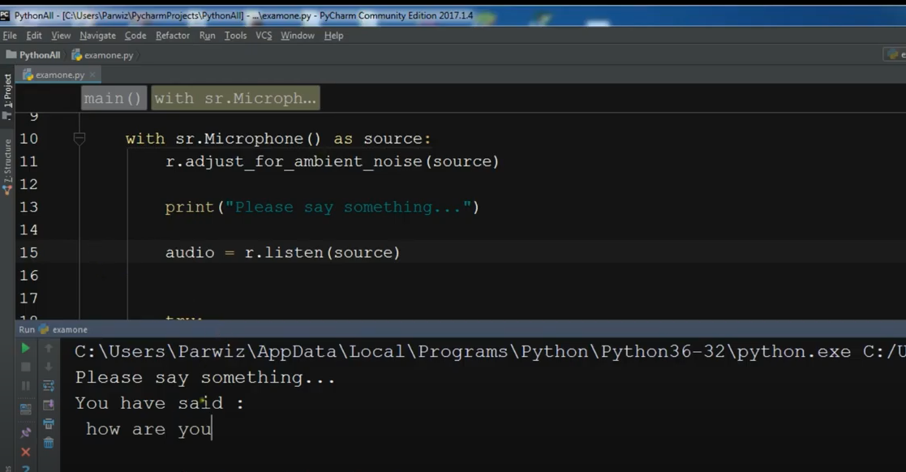
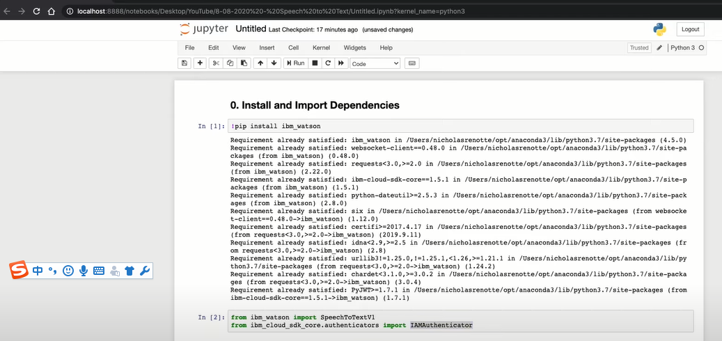
We have set up the speech to text api environment and written codes to apply the function. And the function was operated successfully in both Jupyter Notebook and Python

Slide 3
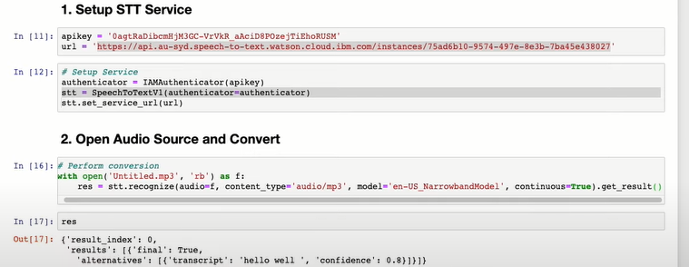
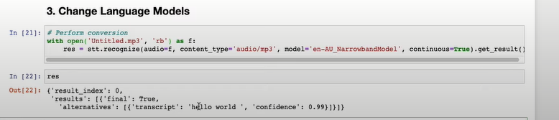
And we have also tested some audio sources and it gives out accurate results. Furthermore, we added some different language models in order to satisfy users from various countries

Slide 4
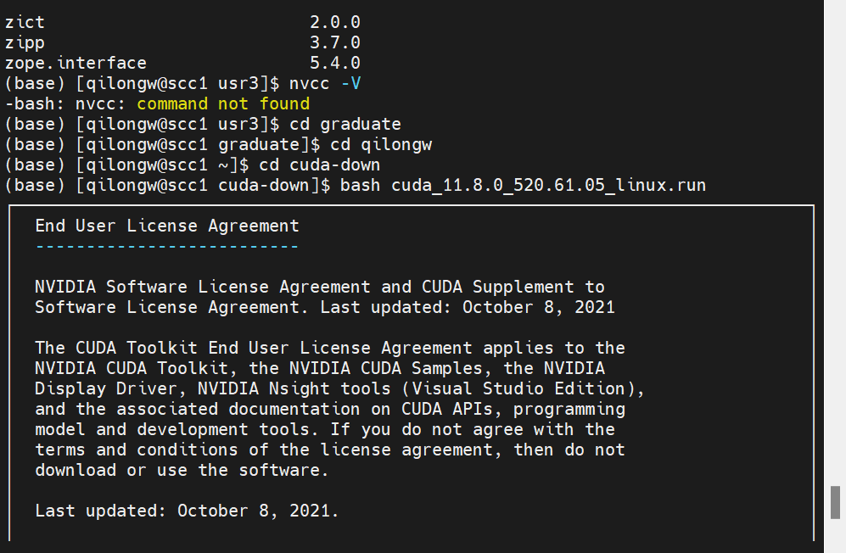
Set up SCC

Slide 5
Sprint 4 goal
Continue working around in SCC and solve current issues
Try to combine speech to text api and vqa module
Apply the vizwiz dataset in the model.

